Slide 1
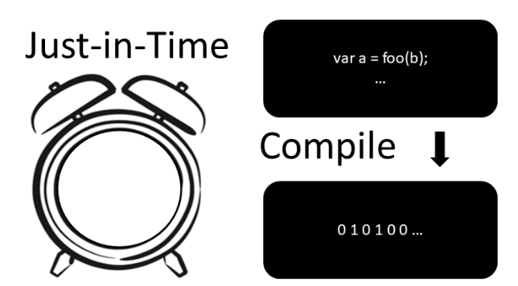
Workshop
Made by Jorge and Thijs

Slide 2
Table of contents
Compiler vs interpreter 15 min(Thijs)
What is compiler/interpreter?
How do they work?
What is JIT compiler? 5 min(Jorge)
What are the pros and cons of using jit compiler? 5 min(Jorge)
What are use cases for JIT compiler? 5 min(Jorge)
Exercises (GitHub) 30 min(Thijs en Jorge)
Future JIT? 2 min(Thijs)
Quizz /Reflection min(Jorge) 10 minuten
Questions 5 min(Thijs)

Slide 3
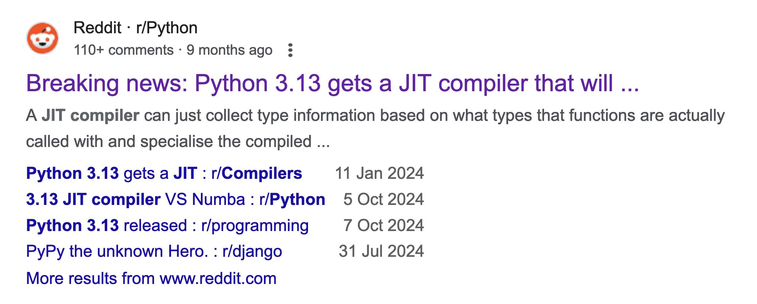
Why?

Slide 4
Compiler vs Interpreter?
Aspect | Compiler | Interpreter
Translation Method | Translates code into machine code | Executes code line by line
Output | Creates an independent executable | No independent file; runs in real-time
Execution Speed | Faster (precompiled code) | Slower (interpreted at runtime)
Error Reporting | All errors reported at compile time | Errors detected during execution
Dependency | No dependency on the compiler post-build | Requires interpreter at runtime
Examples | C, C++, Rust, Go | Python, JavaScript, Ruby
AOT (Ahead of Time) Compiler

Slide 5
Type
 | Type checking is performed ..
Statically typed | At compile time
Dynamically typed | At run time

Slide 6
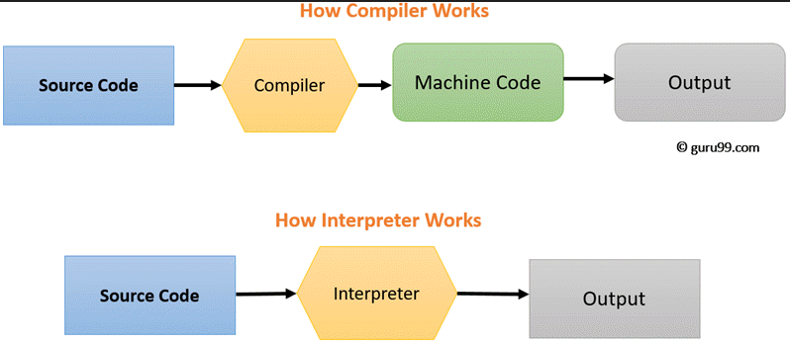
How does a compiler/interpreter work?

Slide 7
Compiled/interpreted - hybrid
Statically typed
C / C++ / Rust
Java, C# (Virtual Machine)
Dynamically typed
JavaScript
Engines like V8 (Node.js / Chrome / Edge)
Python (CPython (reference) / PyPy), also Virtual Machine
Bash
Type blurring

Slide 8
Compiled/interpreted - hybrid
Ahead of time (AOT) compiling
Just-in-time (JIT) compiling
Statically typed
C / C++ / Rust
Java, C# (Virtual Machine)
Dynamically typed
JavaScript
Engines like V8 (Node.js / Chrome / Edge)
Python (CPython (reference) / PyPy), also Virtual Machine
Bash
Type blurring

Slide 9
Questions so far?

Slide 10
What is just-in-time (JIT) compilation (also dynamic translation or run-time compilations)
John McCarthy in 1960.
method for improving the performance of interpreted programs.
dynamic compilation vs static compilation

Slide 11

LISP programming language
Dynamic Typing
First interpreter
played a significant role for optimization techniques

Slide 12
What is JIT compiler?
John McCarthy in 1960.
method for improving the performance of interpreted programs.
dynamic compilation vs static compilation

Slide 13

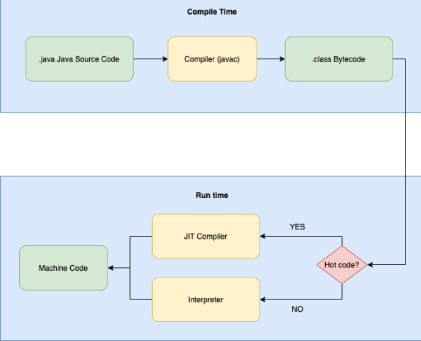
How does it work?
Hot code==pattern
JIT Compiler==cache
Interpreter==output
Machine instructions

Slide 14
What are the pros and cons of using jit compiler?
Advantages:
Adaptive optimizations based on actual usage.
Platform independence (for languages like Java and C#).
Faster execution after initial compilation.
Disadvantages:
Warming startup delay due to JIT compilation.
Memory overhead for both compiled and interpreted code.
Complexity in development and debugging.

Slide 15
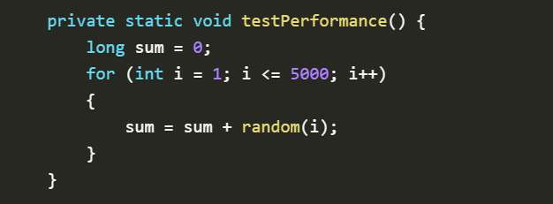
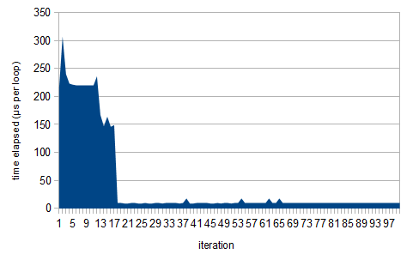
Warming-up JIT Compiler
The program runs a test 100 times
Initial delay
More CPU usage
Memory overhead

Slide 16
What are use cases for JIT compiler?
Virtual machines
Dynamic languages(e.g. Javascript)
Gaming and graphics
Companies that work with big data

Slide 17
Where NOT to use JIT compiler
Programs with simplicity
Interpreters are easy to implement
Resource Constraints
Security Concerns
Examples are: C, C++, Rust, Go

Slide 18
Questions so far?

Slide 19

Exercises
github.com/sebivenlo/
esd-2024-jit-compiler

Slide 20
What’s the future of JIT?
Dynamically vs statically typed
JIT compilation reduced the performance gap.
Statically typed languages will die?
No, the world (AI, high performance) need more speed and reliability.
9 oct 2024: Python (default) introduces JIT
ML/AI in JIT

Slide 21
Questions so far?

Slide 22
QUIZZ
Follow the steps to join the quizz game:
Go to link: https://quizizz.com/join
Insert the code provided at the workshop
Wait until everyone is ready to play
Have fun

Slide 23
Reflection
Did this workshop help you understand what JIT compilation can offer?
Is there a specific topic related to JIT compilation that you would like to learn more about or dive deeper into?
Did you enjoy the workshop?

Slide 24
Thank you for your attention.

